Slide 1
Chat More: Deepening and Widening the Chatting Topic via A Deep Model
姓名：周威信
日期：2018年5月24日
Notes:
Good afternoon everyone.
My name is ZhouWeixin.
I will discuss this paper calling …

Slide 2
1 Background
Dialog system:
1) Task-oriented: vertical domains
2) Non-task-oriented: open-domain topics
Implement methods:
1) Rule-based: restrict diversity
2) Retrieval-based: depend repository
3) Generation-based: more flexible
a) Single-turn: neglect historical conversation
b) Multi-turn
Notes:
1）The past decade has witnessed the boom of human-machine interactions, particularly via dialog systems.
Dialog systems have been widely used in a variety of applications, spanning from entertainment and knowledge sharing, to customer services.
Dialog systems can be divided into task-oriented and non-task-oriented categories. The former studies vertical domains. The latter studies open-domain topics.
2）Implement methods mainly includes rule-based, retrieval-based and generation-based methods.
To be more specific, the rule-based methods restrict diversity, the retrieval-based methods depend repository, the generation-based methods are more flexible.
And the generation-based methods can divide into single-turn and multi-turn models.
Where, single-turn models neglect the context of conversation. Multi-turn generation-based methods are the best and the hardest.

Slide 3
2 Research Problem
Response generation in open-domain multi-turn dialog systems
A dialog session:
Person A: There is a heavy rain today.
Person B: The umbrella is totally useless.
Person A: The rain is really heavy. I got wet in the afternoon and caught a cold at night.
Person B: You should take some hot tea and get a good sleep.
Topic penetration
Topic extension
Notes:
In this paper, authors study the task of response generation in open-domain multi-turn dialog systems.
“really heavy” shows the topic penetration.
This shows the topic extension.
The topic is deepened and widened.

Slide 4
3 Existing Research Defects
1) Without elaborated distinction, incorporates noises
2) No more attractive and meaningful
3) Dull response
Notes:
The first, the majority of prior eﬀorts consider all the phrases in the entire context without elaborated distinction, which indeed incorporates noises and may thus hurt the desired performance.
The second, Fewer researchers thus far have addressed the issue that making the conversation to be more attractive and meaningful.
The last, current generation-based systems frequently generate dull responses, which are not informative or meaningless. For example, I don’t know.

Slide 5
4 Challenges
1) How to identify the relevant words to eﬀectively guide the response generation?
2) How to avoid dull responses and generate responses that are not only relevant but also capable of deepening and widening the dialog topics?
3) How to construct a large-scale dataset for generation-based models?

Slide 6
5 Contributions
1) Separate the topic-related keywords from the irrelevant ones, avoid dull responses
2) Hybrid RNN and DNN model to deepen and widen the chatting topic firstly
3) Construct a dataset of multi-turn dialogs in the open domain and release the data, code and parameters

Slide 7
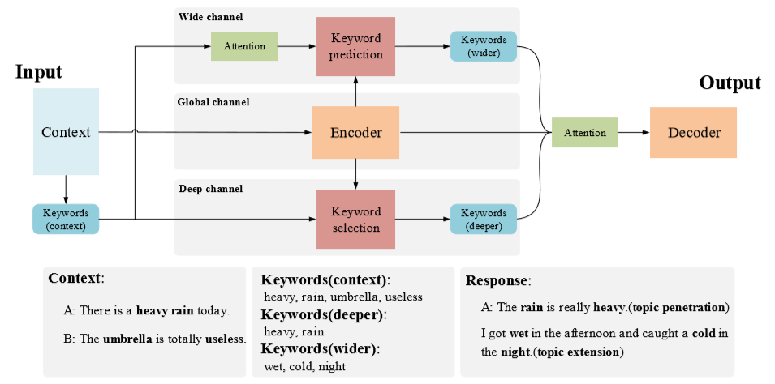
6 Model-DAWnet
Notes:
To deepen and widen the chatting topics, this paper present a scheme to explore the keywords in a dialog as shown in the picture.
The scheme ﬁrst segments the utterances and extracts the keywords from the context.
After that, the model inputs the context and its keywords into three parallel channels, namely, global, wide and deep channels. These channels respectively encode the context into an embedding vector,
predict wider keywords,
and select deeper keywords based on the context and its keywords.
Ultimately, the model adopts an attention mechanism to weigh the context and keywords before feeding them into the RNN decoder that is used to generate a response.
I repeat the process in Chinese.
Let’s detail each component of this scheme.

Slide 8
6.1 Keyword Extraction
Context:
A: There is a heavy rain today.
B: The umbrella is totally useless.
Context Keywords:
heavy, rain, umbrella, useless
Session
Word
Document
Term
TF-IDF
Notes:
This part, the authors apply TF-IDF to extract keywords from the context.
They removed the stop words and only retained nouns, verbs, and adjectives in corpus.
- They consider a session as a document and a word as a term to calculate the TF-IDF value of each word.
They finally chose top 20 keywords from each session.

Slide 9
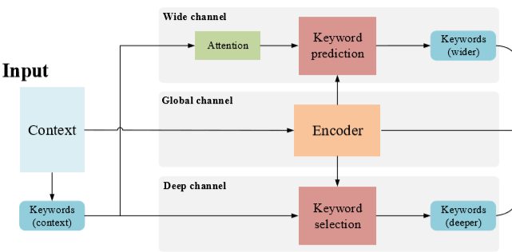

6.2 Global Channel
GRU: encode the given context into a vector
Notes:
In this channel, the authors apply a RNN equipped with GRU to encode the given context into a vector.
W is a sequence of tokens.
H is the hidden layer output.

Slide 10
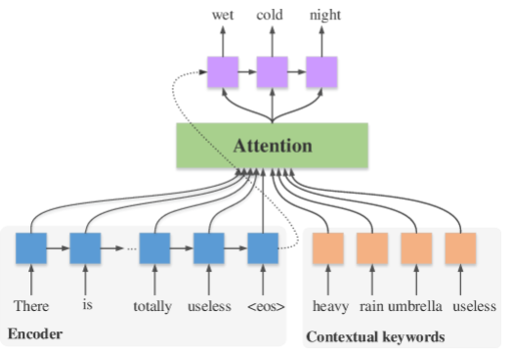
6.3 Wide Channel
Train an attention-based RNN model to predict keywords to extend topics
Notes:
In wide channel, authors train an attention-based RNN model to predict keywords to extend topics.

Slide 11
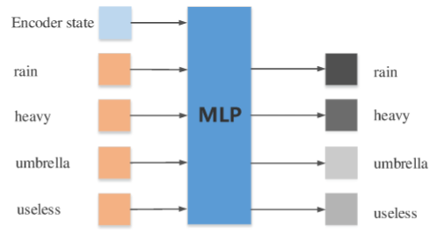
6.4 Deep Channel
Train an MLP to choose the useful keywords from the context
to deepen the topic of interest.
Notes:
The objective of the deep channel is to choose the useful keywords from the context to deepen the topic of interest.

Slide 12
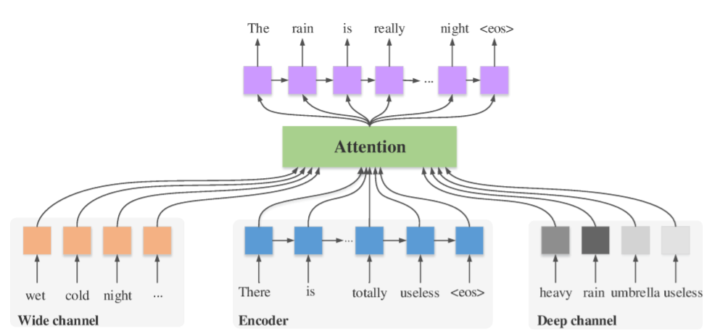
6.5 Decoder
Notes:
This decoder module is similar to wide module. The inputs are different.

Slide 13
7.1 Dataset
Dataset | Train | Valid | Test | Language
Daily Dialog | 11,118 | 1,000 | 1,000 | English
Sina Weibo Conversation | 1,407,119 | 9,000 | 9,000 | Chinese
Dataset rules:
The turns in the session are more than three
The response is meaningful and has two keywords at least. The keywords refer to those with the TF-IDF value no less than a given threshold.
Notes:
Daily Dialog is a standard and open-domain multi-turn dialog English dataset.
Sina Weibo Conversation Corpus is a representative Chinese dataset constructed the authors.
In the two datasets, the last utterance was used as the response and the remaining ones were treated as the context.
The keywords in a response were divided into two categories: the predicted keywords and the selected ones. The selected keywords directly relate to the current topic, and appear in the context; whereas the predicted ones are relevant to the topic but not necessarily occur in the context.

Slide 14
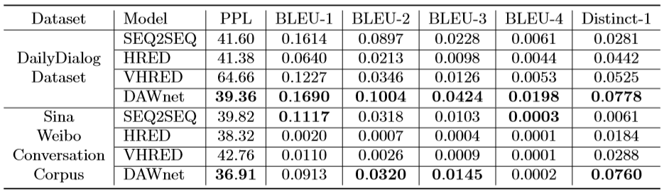
7.2 Experiment(1)
Overall Performance:
Notes:
The baseline of experiment have SEQ2SEQ, HRED and VHRED.
The evaluation metric of experiment have PPL, BLEU-n, Distinct-1.
From the picture, we can find
1) The model achieves the lowest perplexity on the two datasets. The advantageous performance veriﬁes that the predicted and selected keywords actually provide more information to beneﬁt the model
2) The higher BLEU values demonstrate the responses are closer to the ground truth.
3) The Distinct-1 value is much higher than all the baselines, which demonstrates that DAWnet can generate more diﬀerent words and the responses are hence more diverse.

Slide 15
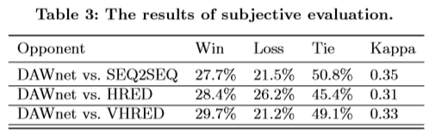
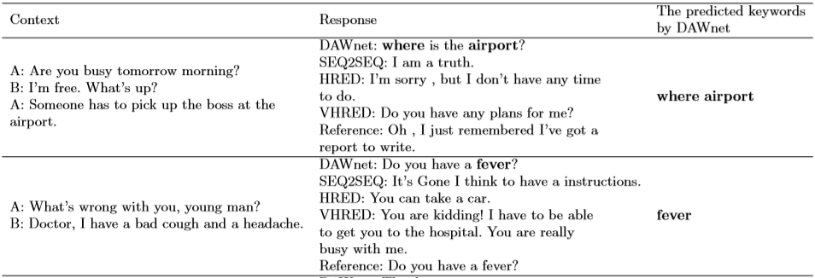
7.2 Experiment(2)
Subjective Evaluation
Notes:
From the picture, we can find
DAWnet outperforms the baselines. Among the three baselines, SEQ2SEQ performs the worst and HRED the best.
Over 45% of the triplets were labeled as ”tie”. By checking these samples, they found most of them are illogical or irrelevant.

Slide 16
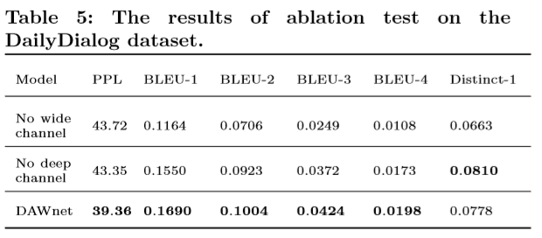
7.2 Experiment(3)
Model Ablation

Slide 17
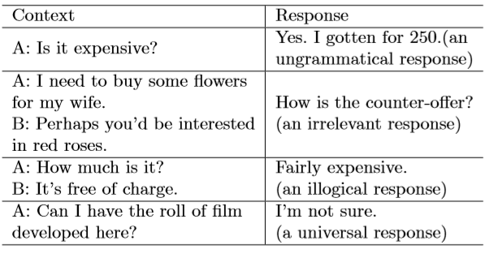
7.2 Experiment(4)
Error Analysis
 | Ungrammatical | Irrelevant | Illogical | Universal responses
Error | 25.8% | 27.9% | 37.6% | 8.6%
Notes:
The authors chose the bad samples judged during the subjective evaluation and analyzed why they were worse in the comparison.
The bad cases fall into four categories: the ungrammatical response, the irrelevant response, the illogical response, and the universal response.

Slide 18
8 Thinking
Innovations:
Study the context-aware dialog systems
Deepen and widen the chatting topic
Thinking:
Sentiment
Improve logical and semantic consistency
Word extraction + Phrase extraction
Notes:
How to add a semantic module in the DAWnet?
How to improve logical and semantic consistency between the responses and the historical contexts?
How to combine word extraction and phrase extraction?

Slide 19
THANK YOU

